Slide 1
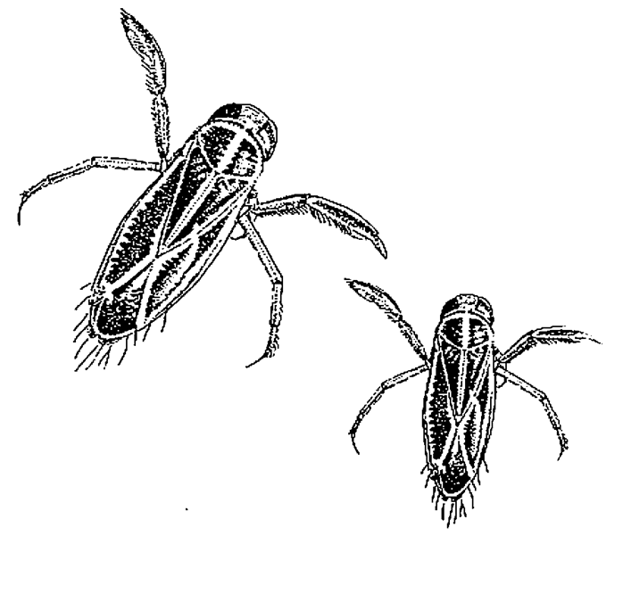
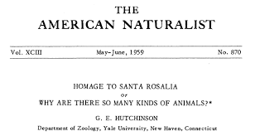
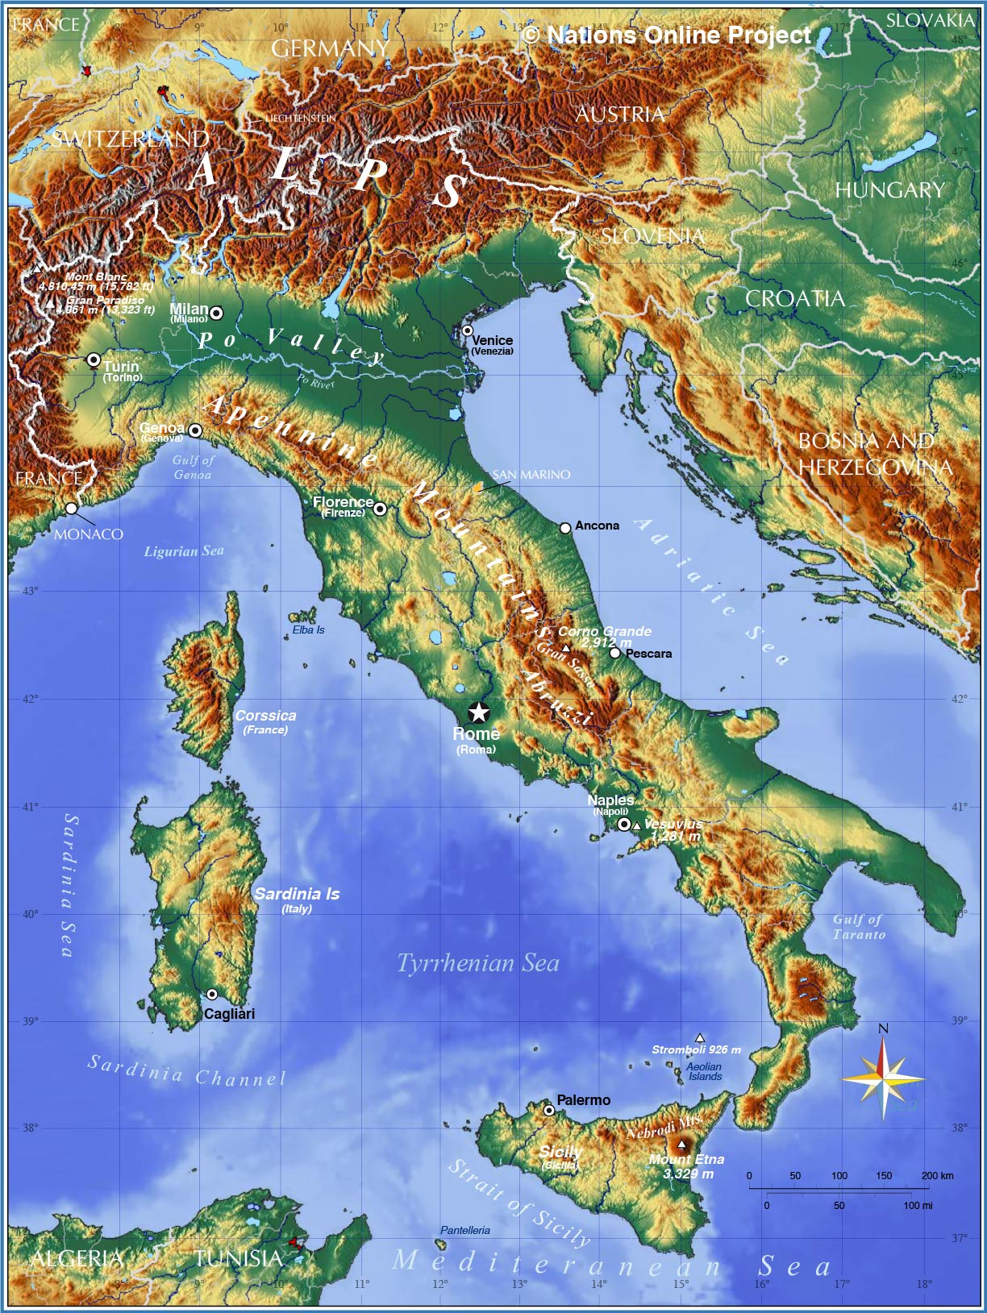
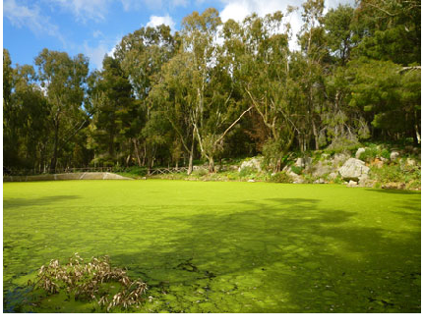
Limits to diversity
Diversity gradients
Niche differences
Body size differences
Energetics
Ecosystem functions
Local-regional dynamics
Biogeographic constraints

Slide 2
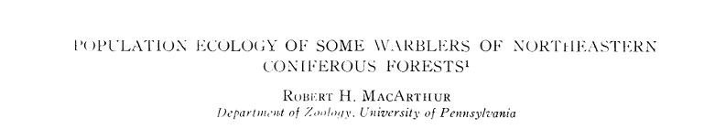
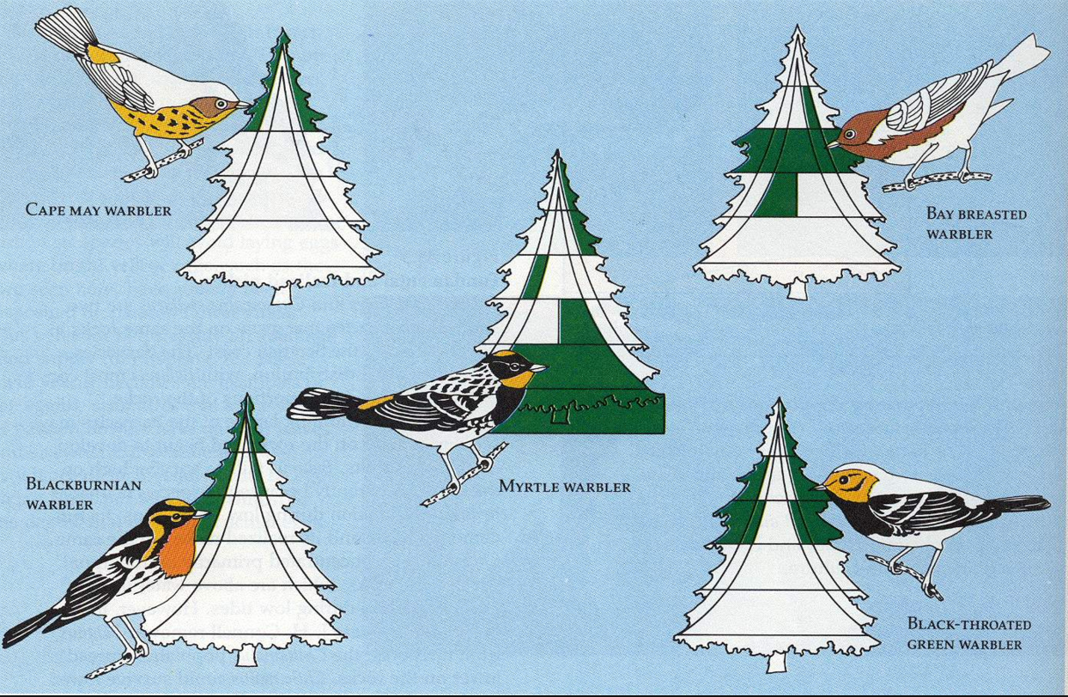
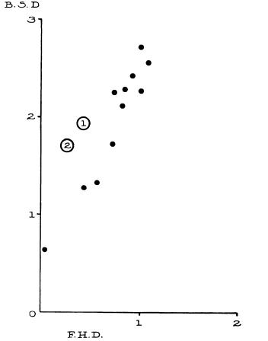
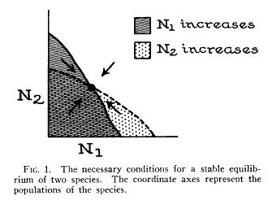
Coexistence and being ‘different’
Bird Diversity
1957
Foliage Height Diversity

Slide 3
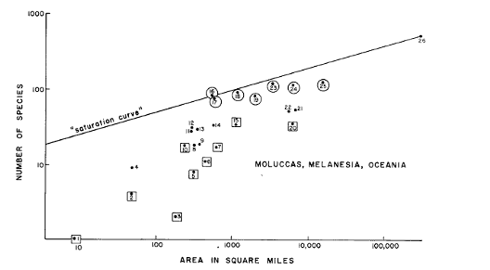
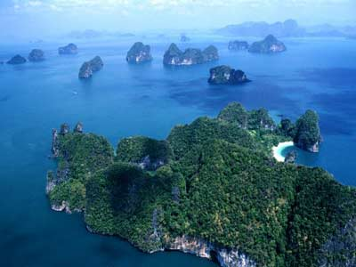
The role of space…
MacArthur and Wilson 1963

Slide 4
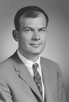
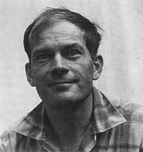
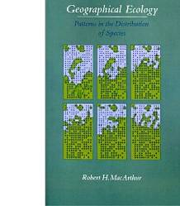
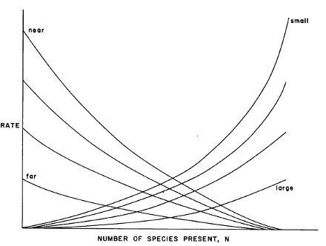
“MacArthur’s Paradox” and the Metacommunity
Local perspective
Regional perspective
Original Resource Ratio Model
Basis for Niche Theory
Theory of Island Biogeography:
Basis for Neutral Theory

Slide 5
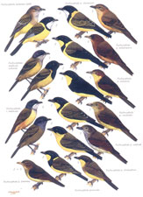
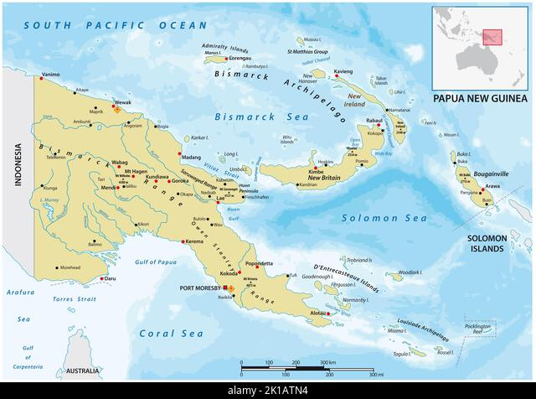
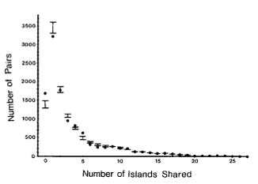
Diamond’s ‘Assembly Rules’

Slide 6
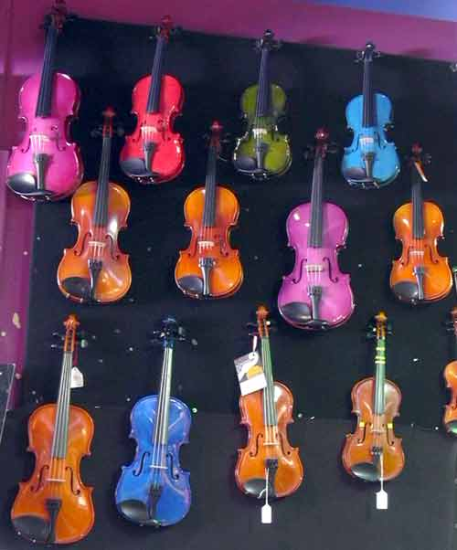
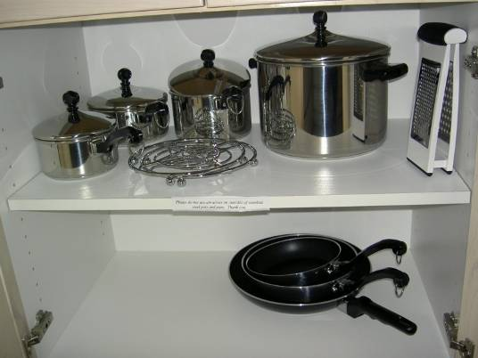
The ‘Null Model’ Wars
-D. Simberloff

Slide 7
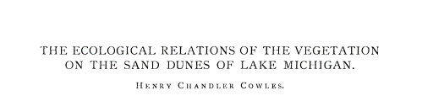

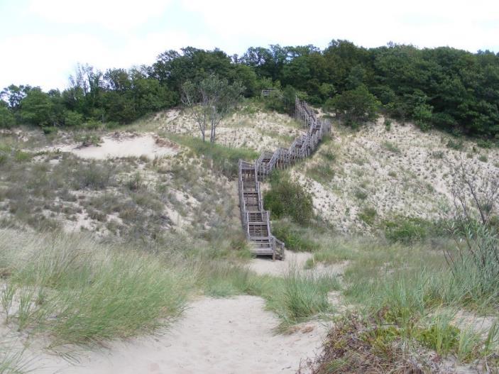
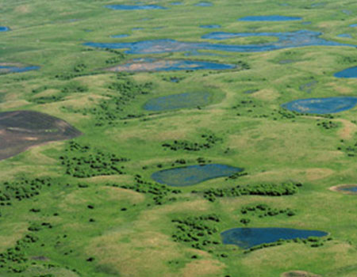
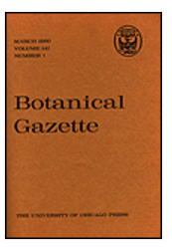
Just How Predictable are Communities?
… Cooper, Egler, others
…Clements, others

Slide 8
How Predictable? A Debate that has Spanned the Ages
1920’s-1930’s
Super-organismic vs Individualistic Succession
(Cowles, Clements vs. Cooper, Gleason)
1940-1960’s Competitive exclusion vs Randomness
(Hutchinson, Elton, Lack vs. Diver, Riley)
Many other ‘problems’ and debates in our field change the words and approaches, but the concepts are often the same
Density-dependence
Role of trophic interactions
Biogeography/evolution vs ecology
Etcetera
1970’s-1980’s
Assembly Rules vs Null Models
(Diamond vs. Simberloff)
1980’s-1990’s
Lottery Models vs Coexistence
(Sale vs. Chesson)
2000-2010’s
Niche vs Neutral

Slide 9
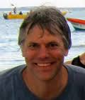
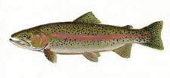
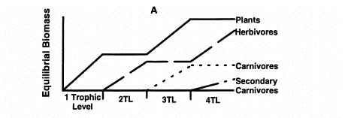
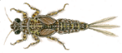

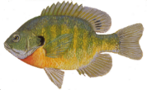
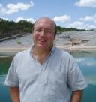
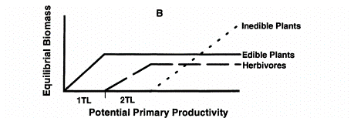
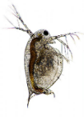
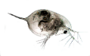

My First Experience with ‘Synthesis’: Top Down vs. Bottom Up
Thesis:
Hairston et al. 1960 (HSS), Fretwell 1977
Oksanen et al. 1981
Potential Primary Productivity
Most ecological debates can be synthesized
with ‘perspective’ and ‘scale’
Disturbance and trade-offs
Anti-Thesis: Leibold 1989

Slide 10
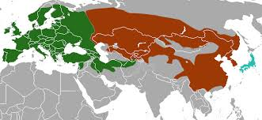

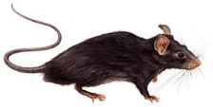
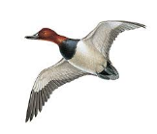
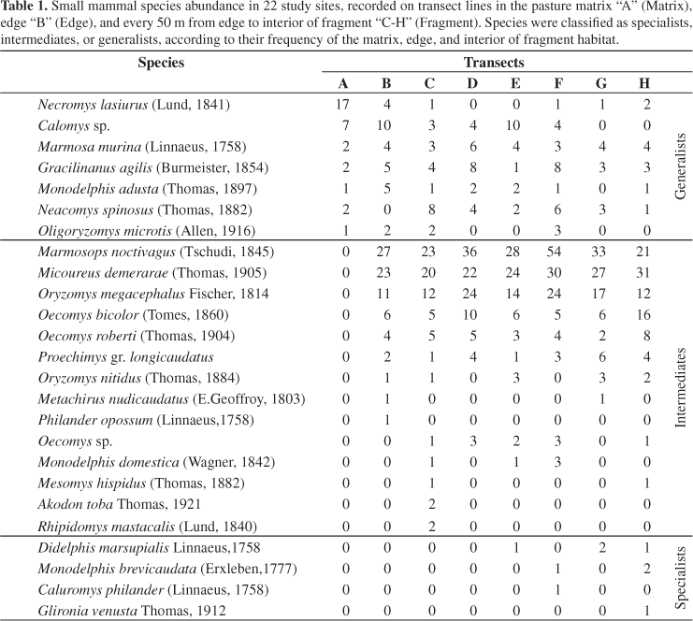
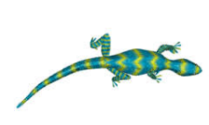
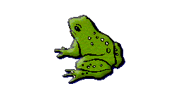
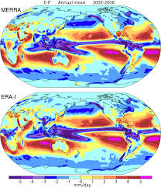
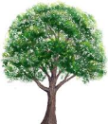

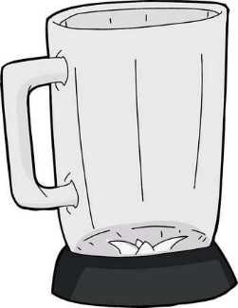
What is “Synthesis” in Ecology?
Big Data
Biodiversity Informatics
Hierarchical Bayesian Analyses
….
Synthesis??

Slide 11
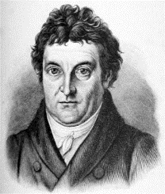
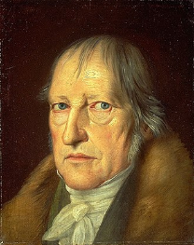
The Dialectic:
These, Antithese, Synthese
Thesis
Anti-Thesis
Johann Fichte
Synthesis
New Thesis
New
Anti-Thesis
Synthesis 2.0
Georg Hegel

Slide 12
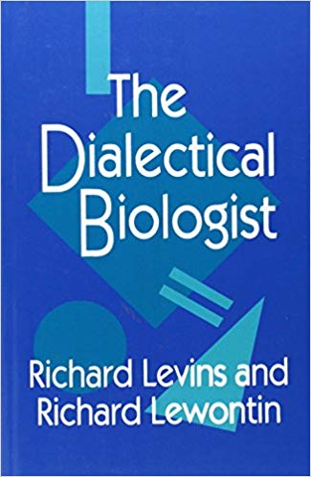
Scientists act within a social context... Whether they realize it or not, scientists always choose sides.
…this book questions our accepted definitions and biases, showing the self-reflective nature of scientific activity within society.
Levins, R. and R.C. Lewontin, 1985. The Dialectical Biologist, Harvard University Press

Slide 13
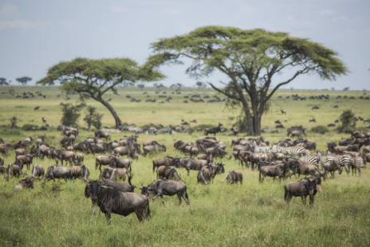
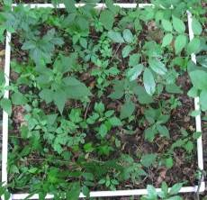
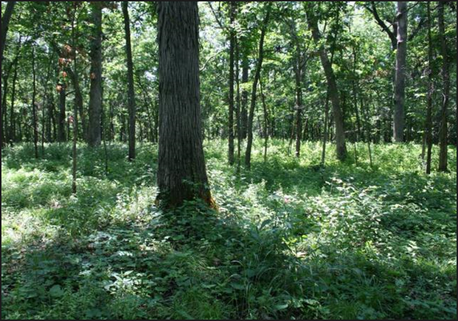
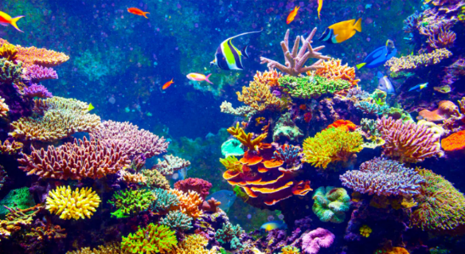
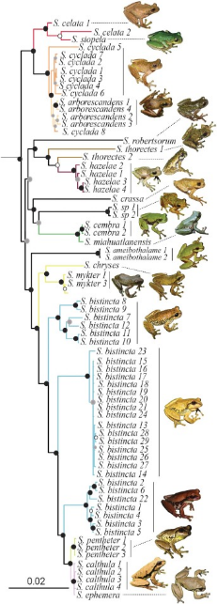
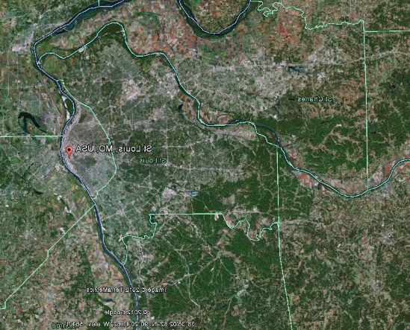


What is a ‘Community’? Synthesis with Context and Scale
Time

Slide 14
Discussion: Culture and bias in Community Ecology

Slide 15














Bias and culture in community ecology (and all science): History

Slide 16



Bias and culture in community ecology (and all science): Today

